Slide 1
SQL Server
Stored Procedures
In all slides, db=database

Slide 2
SPROCS
A stored procedure is sometimes referred to as a sproc.
It is really just something of a script (or maybe more appropriate a batch) that is stored in the database rather than in a separate file.
Stored procedures have things that scripts don’t have such as input and output parameters and return values.

Slide 3
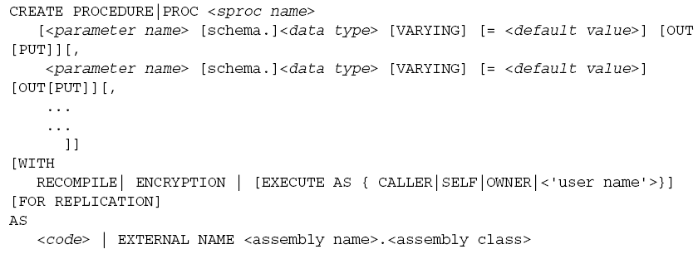
Creating a SPROC
Creating a sproc works pretty much the same as creating any other object in a database, except that it uses the AS keyword that you first saw when we took a look at views:

Slide 4

An Example of a Basic Sproc
Adding a stored procedure to select all from shippers on Northwind:
To run it, type in:

Slide 5
Parameters
It doesn’t do much good to have a stored procedure to delete something if we can’t tell it what we want to delete, so we use an input parameter.

Slide 6
Declaring Parameters
Declaring a parameter requires two to four of these pieces of information:
  The name - must start with the @ sign, follows all other rules
  The datatype -must be declared just as you would for a variable—with a valid SQL Server built-in or user defined datatype.
  The default value - if not supplied, the parameter is required
  The direction – input or output.

Slide 7
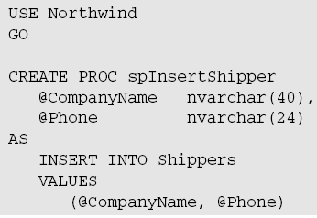
Using Input Parameters
Using parameters with no default value makes the parameters required.
To call this procedure:

Slide 8
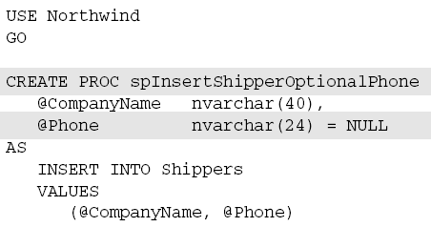
Supplying Default Values
To make a parameter optional, you have to supply a default value. To do this, you just add an = with the value you want to use for a default after the datatype but before the comma.
In this case, the
phone is now
optional & the
sproc can be used
without it:

Slide 9
Creating Output Parameters
Sometimes you want to pass non-recordset information out to whatever called your sproc.
To do so you use an output parameter in your parameter list
  Use keyword OUTPUT or OUT
  @OrderID int OUTPUT

Slide 10
Example of Output Parameters
Maybe we’re inserting a new record into our Orders table in Northwind, but we also need to insert detail records in the Order Details table.
In order to keep the relationship intact, we have to know the identity of the Orders record before we can do our inserts into the Order Details table.

Slide 11
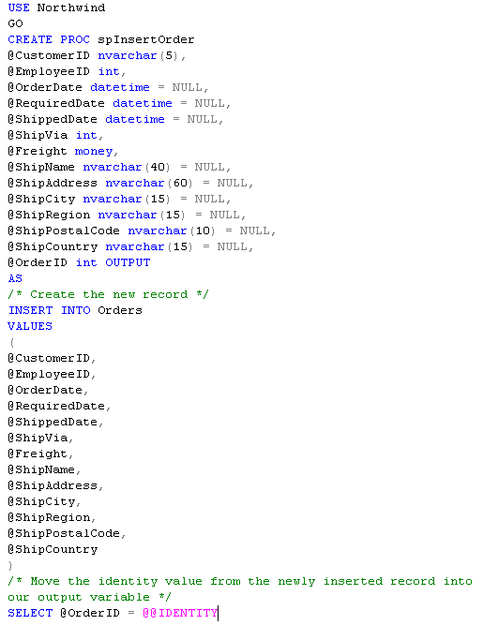
Creating the
SPROC
Script to create
a SPROC.

Slide 12
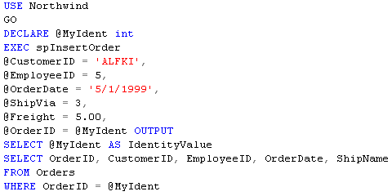
Running the SPROC
Notice that we didn’t supply all of the parameters.
Some of them were optional, and we decided to leave some of those off—which would take the default value.
Notes:
The OUTPUT keyword was required for the output parameter in the sproc declaration.
-You must use the OUTPUT keyword when you call the sproc, much as you did when you declared
the sproc. This gives SQL Server advance warning about the special handling that parameter will
require. Be aware, however, that forgetting to include the OUTPUT keyword won’t create a runtime
error (you won’t get any messages about it), but the value for the output parameter won’t
be moved into your variable ,you’ll just wind up with what was already there—most likely a
NULL value. This means that you’ll have what I consider to be the most dreadful of all computer
terms—unpredictable results.
- The variable you assign the output result to does not have to have the same name as the internal
parameter in the sproc. For example, in our previous sproc, the internal parameter was called
@OrderID, but the variable the value was passed to was called @MyIdent.
-The EXEC (or EXECUTE) keyword was required since the call to the sproc wasn’t the first thing in
the batch (you can leave off the EXEC if the sproc call is the first thing in a batch)—personally, I
recommend that you train yourself to use it regardless.

Slide 13
Running the SPROC (CONT’D)
The OUTPUT keyword was required for the output parameter in the sproc declaration.
You must use the OUTPUT keyword when you call the sproc, much as you did when you declared the sproc.
The variable you assign the output result to does not have to have the same name as the internal parameter in the sproc. For example, in our previous sproc, the internal parameter was called @OrderID, but the variable the value was passed to was called @MyIdent.

Slide 14
Running the SPROC (CONT’D)
The EXEC (or EXECUTE) keyword was required since the call to the sproc wasn’t the first thing in the batch (you can leave off the EXEC if the sproc call is the first thing in a batch)—personally, I recommend that you train yourself to use it regardless.

Slide 15
Setting Parameter Values
Note that parameter values can be set by reference or by position
  By reference – parameters are named when the stored procedure is executed
    EXEC spInsertOrder
    @CustomerID = ‘ALFKI’,
    …
  By position
    EXEC spInsertShippersOptionalPhone ‘Speedy Shippers’
If using positional parameters, then we would have had to address each position in the parameter list until the last parameter for which we want to supply a value

Slide 16
Control of Flow Statements
What if you need to only execute a particular line of code in certain situations (i.e. conditionally)?
SQL Server offers most of the classic choices for control of flow situations
  IF . . . ELSE
  GOTO
  WHILE
  WAITFOR
  TRY/CATCH

Slide 17
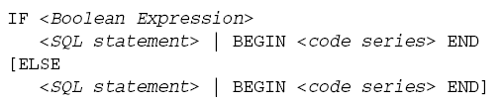
If/Else
If/Else – if some condition do this, else do something else.
Remember when checking for null values – this will not work:
IF @myvar=null
Instead, use:
IF @myvar IS NULL

Slide 18
If/Else (Cont’d)
If you only have one statement to execute conditionally, you can just specify the statement. If you have more than one statement to execute within the conditional, you need to use BEGIN and END to group them together.

Slide 19

If/Else – A Simple Example
IF DATEDIFF (dd, @OrderDate, GETDATE()) > 7
  SELECT @OrderDate = NULL

Slide 20
If/Else – Using the Else
See modified code below adds an ELSE to the conditional
/* Test to see if supplied date is over 7 days old, if so
** replace with NULL value
** otherwise truncate the time to be midnight */
IF DATEDIFF(dd, @OrderDate, GETDATE()) > 7
SELECT @InsertedOrderDate = NULL
ELSE
SELECT @InsertedOrderDate =
CONVERT(datetime, (CONVERT(varchar, @OrderDate, 112)))

Slide 21
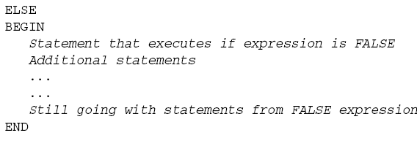
Grouping Code into Blocks
Sometimes you need to treat a group of statements as though they were all one statement (if you execute one you execute all – otherwise you don’t execute any of them)
SQL Server gives us a way to group code into blocks that are considered to all belong together. The block is started when you issue a BEGIN statement, and continues until you issue an END statement.
Note that blocks can be nested
Notes:
Sometimes you need to treat a group of statements as though they were all one statement (if you execute
one, then you execute them all—otherwise, you don’t execute any of them). For instance, the IF statement
will, by default, only consider the very next statement after the IF to be part of the conditional code. What
if you want the condition to require several statements to run? Life would be pretty miserable if you had to
create a separate IF statement for each line of code you wanted to run if the condition holds.

Slide 22

CASE
A CASE statement is another control flow construct
Similar to
  Switch statement in C, C++, C#
  Select Case in Visual Basic
Allows you to evaluate an input expression and execute the appropriate result expression
Notes:
For those of you who aren’t familiar with it, the % operator is for a modulus. A modulus works in a similar
manner to the divide by (/), but it only gives you the remainder. Therefore, 16 % 4 = 0 (4 goes into
16 evenly); but 16 % 5 = 1 (16 divided by 5 has a remainder of 1).

Slide 23
CASE
A simple CASE takes an expression that equates to a Boolean result.
Notice that whenever there is
a matching value
in the list, the THEN
clause is invoked.
Since we have an
ELSE clause, any
value that doesn’t
match one of the
previous values will be assigned whatever we’ve put in our ELSE.
USE Northwind
GO
SELECT TOP 10 OrderID, OrderID % 10 AS ‘Last Digit’, Position =
CASE OrderID % 10
WHEN 1 THEN ‘First’
WHEN 2 THEN ‘Second’
WHEN 3 THEN ‘Third’
WHEN 4 THEN ‘Fourth’
ELSE ‘Something Else’
END
FROM Orders
Notes:
For those of you who aren’t familiar with it, the % operator is for a modulus. A modulus works in a similar
manner to the divide by (/), but it only gives you the remainder. Therefore, 16 % 4 = 0 (4 goes into
16 evenly); but 16 % 5 = 1 (16 divided by 5 has a remainder of 1).

Slide 24
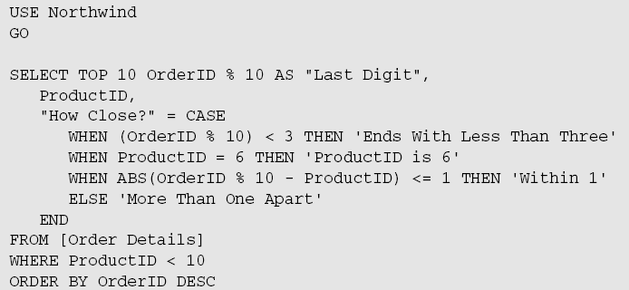
SEARCHED CASE
There is no input expression (remember that’s the part between the CASE and the first WHEN).
The WHEN expression must evaluate to a Boolean
value.

Slide 25
SEARCHED CASE (CONT’D)
Why use a ‘Searched’ CASE?
  Note that you can completely change around what is forming the basis of the comparison.

Slide 26
SEARCHED CASE (CONT’D)
Even when two conditions evaluate to true, only the first condition is used.
As noted, you can mix and match what fields you are using in your condition expressions.
  In our example we used ProductID and OrderID
You can evaluate pretty much any expression as long as it evaluates to a boolean (true or false)

Slide 27
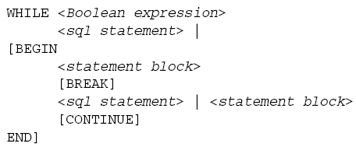
WHILE
The WHILE statement works much as it does in other languages
A condition is tested each time you come to the top of the loop. If the condition is still TRUE, then the loop executes again—if not, you exit.
Notes:
There are often things that you either don’t want to or simply can’t have happen right this moment, but
you also don’t want to have to hang around waiting for the right time to execute something.No problem—use the WAITFOR statement and have SQL Server wait for you. The syntax is incredibly
simple:
WAITFOR
DELAY <’time’> | TIME <’time’>
The WAITFOR statement does exactly what it says it does—that is, it waits for whatever you specify as
the argument to occur. You can specify either an explicit time of day for something to happen, or you can
specify an amount of time to wait before doing something.
The DELAY parameter choice specifies an amount of time to wait.
The TIME parameter choice specifies to wait until a specific time of day.

Slide 28
WHILE
The BREAK statement is a way of exiting the loop without waiting for the bottom of the loop to come and the expression to be re-evaluated
The CONTINUE tells the loop to go back to the beginning regardless of where you are in the loop.

Slide 29
WHILE – A simple example
This iterates through a counter from 0 to 10 and prints out the value of the counter
DECLARE @counter int
SET @counter = 1
WHILE @counter <= 10
BEGIN
PRINT 'The counter is ' + cast(@counter as char)
SET @counter = @counter + 1
END

Slide 30
WHILE – Another example
This would update the statistics for every table in our database every night at 1am and write a log entry of the fact to both SQL Server log and the Windows NT application log.
WHILE 1 = 1
BEGIN
WAITFOR TIME ‘01:00’
EXEC sp_updatestats
RAISEERROR(‘Statistics Updated for Database’, 1, 1) WITH LOG
END

Slide 31
WAITFOR
Have SQL Server wait for you.
WAITFOR DELAY <’time’> | TIME <’time’>
The WAITFOR statement does exactly what it says it does—it waits for whatever you specify.
The DELAY parameter choice specifies an amount of time to wait.
The TIME parameter choice specifies to wait until a specific time of day.
WAITFOR TIME ‘22:20’
  Will wait until 10:20pm
WAITFOR DELAY ‘02:00’
  Will wait for 2 hours

Slide 32
TRY/CATCH Blocks
New functionality added to SQL Server 2005
Try/Catch are language constructs that are designed to handle exceptions.
Will ‘try’ to execute a block of code. If an error is encountered within the block, the control flow will move immediately to the first line of the CATCH block.
More on this is available in Appendix F.

Slide 33
Using Return Values
You can use Return Values to confirm success or failure
A return value is passed back from our sproc to the calling code
Use a RETURN statement within sproc
  RETURN [<integer value to return >]
Note: the RETURN statement unconditionally exits your proc! Nothing after the RETURN will be executed.
By default, SQL Server automatically returns a value of zero.
Return values are accessed from calling code
  EXEC @Return = spTestReturns

Slide 34
Return Values – Example
USE Northwind
GO
CREATE PROC spTestReturns
AS
DECLARE @MyMessage varchar(50)
DECLARE @MyOtherMessage varchar(50)
SELECT @MyMessage = ‘Hi, it’’s that line before the RETURN’
PRINT @MyMessage
RETURN
SELECT @MyOtherMessage = ‘Sorry but we won’’t get this far’
PRINT @MyOtherMessage
RETURN
DECLARE @Return int
EXEC @Return = spTestReturns
SELECT @Return as ‘ReturnValue’

Slide 35
More About Return Values
Don’t mix-up return values with output parameters
Return values: used to indicate success or failure of executed code
Output parameters: used to pass some value back to calling code. For instance, OrderID after the Order row is inserted
Return values and output parameters can be used separately or together – they are separate concepts

Slide 36
Make Sure to Read the Book
Stored Procedures are VERY important. Please read the book carefully.
You will find a quiz and an assignment over this chapter in the Assessments folder.

